Slide 1
Design Instagram

Slide 2
Contents
1. Requirement Gathering
2. Capacity Estimation
3. High-Level Design
4. Database Design
5. Deep Dive into Key Components
6. Address Key Issues and Bottlenecks

Slide 3
1. Requirement Gathering
Functional Requirements
  Publish Posts
  A user can have followers as well as follow others
  Have a news feed - posts are sorted in reverse chronological order.
  Comments, Likes on posts
  Users can perform searches based on photo/video titles.
  Number of followers - max 5000
  Traffic - 10 million users DAU
  Feed contains images, texts and videos.

Slide 4
Non functional requirements
  Our service needs to be highly available.
  The acceptable latency of the system is 200ms for News Feed generation.
  Consistency can take a hit (in the interest of availability), if a user doesn’t see a photo for a while; it should be fine.
  The system should be highly reliable; any uploaded photo or video should never be lost.

Slide 5
2. Capacity Estimation
Let’s assume we have 500 Million total users, with 10 Million DAU.
Each user uploads atleast 2 photos daily.
  Total photos in a day = 20 Million
Average photo/video file size => 1Mb
Total size required in one day = 20M * 1Mb
= 20 * 10^6 * 1Mb
= 20 * 1000 * 1000 * 1Mb
= 20 Tb
Total Space required for 10 years = 20Tb * 365days * 10 = 8000Tb = 1Pb(approx)

Slide 6
3. High-Level Design
On high level we need 2 major service :-
  Uploading photo as post
  Searching posts aka news feed generation.
Newsfeed APIs
The news feed APIs are the primary ways for clients to communicate with servers.
Feed publishing API
POST /v1/me/feed
Params:
• content: content is the text of the post.
• auth_token: it is used to authenticate API requests.
Newsfeed retrieval API
    GET /v1/me/feed
    Params:
    • auth_token: it is used to authenticate API requests.

Slide 7
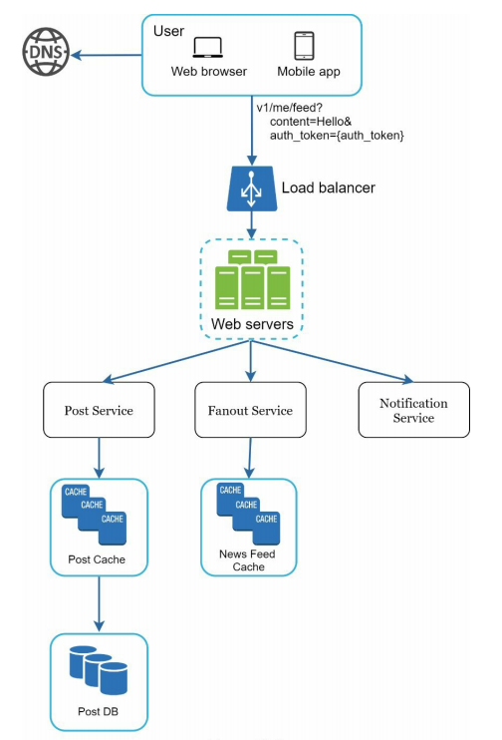
Feed Publishing:
User: a user can view news feeds on a browser or mobile app.
A user makes a post with content “Hello” through API: /v1/me/feed?content=Hello&auth_token={auth_token}
Load balancer: distribute traffic to web servers.
Web servers: web servers redirect traffic to different internal services.
Post service: persist post in the database and cache.
Fanout service: push new content to friends’ news feed. Newsfeed data is stored in the cache for fast retrieval.
Notification service: inform friends that new content is available and send out push notifications.

Slide 8
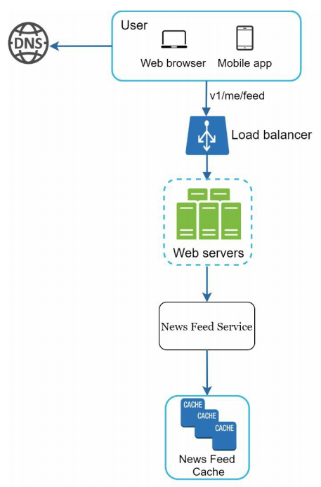
News Feed Building:
User: a user sends a request to retrieve her news feed.
GET: / v1/me/feed.
Load balancer: load balancer redirects traffic to web servers.
Web servers: web servers route requests to newsfeed service.
Newsfeed service: news feed service fetches news feed from the cache.
Newsfeed cache: store news feed IDs needed to render the news feed.

Slide 9
Overall initial design

Slide 10
4. Database Design
To store images we can either go for a distributed file storage like (HDFS, S3) or as blob type in Db.
We would not need the perks of a database while storing the image.
So we can go with a DFS (Distributed File System) to store the images.
We can keep a CDN in front of the DFS to cache the images.
File System | Blob Storage
Cheaper | Access Control
Faster | Mutability (I can change the row in a database)
 | Transaction guarantee
 | Indexes

Slide 11
Post
PK | PostId: uuid
 | UserId: uuid
 | MediaPath: varchar
Nonclustered index | CreationDate: datetime
UserFollower
PK | UserFolloweId: uuid
FK | FollowerId: uuid
FK | FolloweeId: uuid
User
PK | UserId: uuid
 | Name: uuid
 | Email: varchar
 | DateOfBirth: datetime
 | CreationDate: datetime
 | LastLogin: datetime
We need to store data about users, their uploaded photos, and people they follow.
Photo table will store all data related to a photo; we need to have an index on (PhotoID, CreationDate) since we need to fetch recent photos first.
A straightforward approach for storing the above schema would be to use an RDBMS like MySQL since we require joins.
But relational databases come with their challenges, especially when we need to scale them.
We can store the above schema in a distributed key-value store to enjoy the benefits offered by NoSQL. All the metadata related to posts can go to a table where the
  ‘key’ = ‘PhotoID’
  ‘value’ = an object containing PhotoLocation, UserLocation, CreationTimestamp, etc.

Slide 12
Cassandra or key-value stores in general, always maintain a certain number of replicas to offer reliability. Also, in such data stores, deletes don’t get applied instantly, data is retained for certain days (to support undeleting) before getting removed from the system permanently.
UserFollower - GraphDb
UserDb - RDBMS(MySQL)
PostDb - NoSQL (Key Value)
  ‘key’ = ‘PostId
  ‘value’ = an object containing MediaPath, CreationTimestamp, etc.

Slide 13
Likes, Comments
Likes
PK | LikeId: uuid
 | ActivityId: {Post, Comment}
 | UserId: uuid (LikedBy userid)
 | ParentId: uuid (Post/Comment)
 | CreationDate: datetime
 | Active (in case like is deleted)
Post
PK | PostId: uuid
 | UserId: uuid
 | MediaPath: varchar
Nonclustered index | CreationDate: datetime
Comment
PK | CommentId: uuid
 | PostId: uuid
 | Comment: varchar
 | UserId: uuid (commentor)
 | CreationDate: datetime
 | Active (in case like is deleted)
Activity
PK | ActivityId: int
 | ActivityType: varchar
 | PostId: uuid
 | CommentId: uuid | null
 | LikeId: uuid | null
 | LikeCount: bigint

Slide 14
Posts (contains post related data)
  PostId - Primary Key
  UserId - Posted by userid
  MediaPath - DFS path
  CreationDate
Likes
  LikeId - Primary Key
  ActivityId - References whether the like is on a post or on a comment.
  UserId - person who liked it
  ParentId - commentId/postId
  Active - If unliking the like, then soft delete from here
Comments
  CommentId
  PostId - since comment can only be on a post
  UserId - User who commented.
  Comment
  Active - (for soft delete purpose).
Activity - Since we have two types of activities on our post, so this table contains the type and the metadata about it.
  ActivityId - PK
  ActivityType - Enum {comment, like}
  PostId - post on which activity occured
  LikeId
  CommentId
  LikeCount - a counter to fetch the data about the post easily.

Slide 15
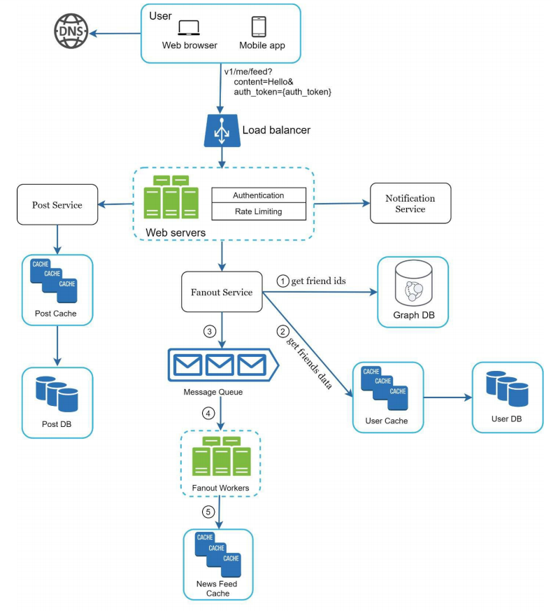
5. Design Deep Dive
A. Feed publishing deep dive
1. Web Servers
Besides communicating with clients, web servers enforce authentication and rate-limiting.
Only users signed in with valid auth_token are allowed to make posts. The system limits the number of posts a user can make within a certain period, vital to prevent spam and abusive content.

Slide 16
2. Fanout service
Fanout is the process of delivering a post to all friends. Two types of fanout models are:
fanout on write (also called push model) and
fanout on read (also called pull model).
Both models have pros and cons. We explain their workflows and explore the best approach to support our system.
Fanout on write - With this approach, news feed is pre-computed during write time.
A new post is delivered to friends’ cache immediately after it is published.
Pros:
• The news feed is generated in real-time and can be pushed to friends immediately.
• Fetching news feed is fast because the news feed is pre-computed during write time.
Cons:
• If a user has many friends, fetching the friend list and generating news feeds for all of them are slow and time consuming. It is called hotkey problem.
• For inactive users or those rarely log in, pre-computing news feeds waste computing resources.

Slide 17
Fanout on read - The news feed is generated during read time. This is an on-demand model. Recent posts are pulled when a user loads her home page.
Pros:
• For inactive users or those who rarely log in, fanout on read works better because it will not waste computing resources on them.
• Data is not pushed to friends so there is no hotkey problem.
Cons:
• Fetching the news feed is slow as the news feed is not pre-computed.
We adopt a hybrid approach to get benefits of both approaches and avoid pitfalls in them.
Since fetching the news feed fast is crucial, we use a push model for the majority of users.
For celebrities or users who have many friends/followers, we let followers pull news content on-demand to avoid system overload.

Slide 18
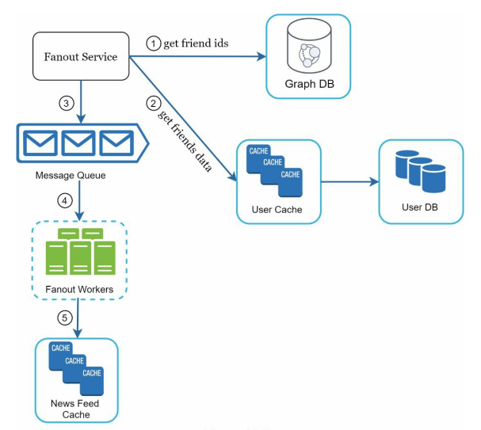
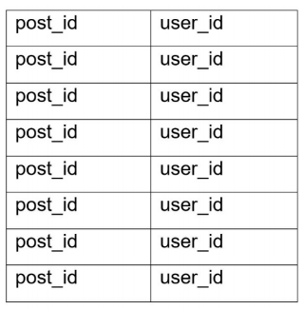
The fanout service works as follows:
1. Fetch friend IDs from the graph database. Graph databases are suited for managing friend relationship and friend recommendations.
2. Get friends info from the user cache. The system then filters out friends based on user settings. For example, if you mute someone, her posts will not show up on your news feed even though you are still friends. Another reason why posts may not show is that a user could selectively share information with specific friends or hide it from other people.
3. Send friends list and new post ID to the message queue.
4. Fanout workers fetch data from the message queue and store news feed data in the news feed cache. The news feed cache is as a <post_id, user_id> mapping table.
Whenever a new post is made, it will be appended to the news feed table. The memory consumption can become very large if we store the entire user and post objects in the cache. Thus, only IDs are stored. To keep the memory size small, we set a configurable limit.
The chance of a user scrolling through thousands of posts in news feed is slim. Most users are only interested in the latest content, so the cache miss rate is low.
5. Store <post_id, user_id > in news feed cache.

Slide 19
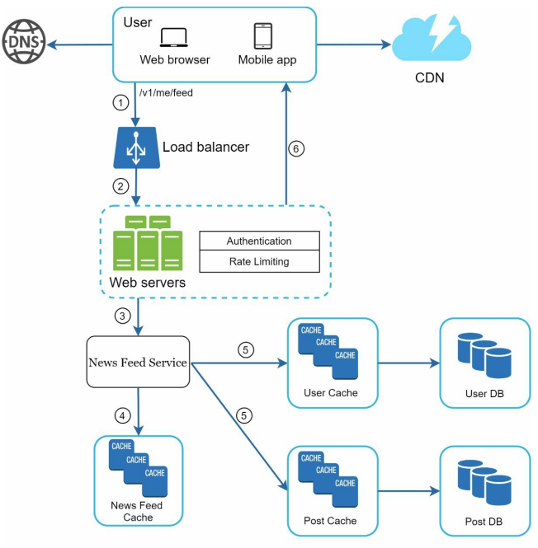
B. Newsfeed retrieval deep dive
Media content (images, videos, etc.) are stored in DFS behind a CDN for fast retrieval.
1. A user sends a request to retrieve her news feed. The request looks like this: /v1/me/feed
2. The load balancer redistributes requests to web servers.
3. Web servers call the news feed service to fetch news feeds.
4. News feed service gets a list post IDs from the news feed cache.
5. A user’s news feed is more than just a list of feed IDs. It contains username, profile picture, post content, post image, etc. Thus, the news feed service fetches the complete user and post objects from caches (user cache and post cache) to construct the fully hydrated news feed.
6. The fully hydrated news feed is returned in JSON format back to the client for rendering.

